Slide 2
A Voice for Change
LAPD – LinCT International Counterterrorism Conference
April 29, 2015
Mary Fetchet, LCSW

Slide 3
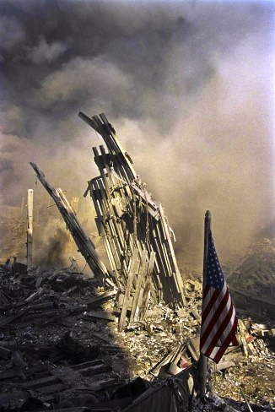
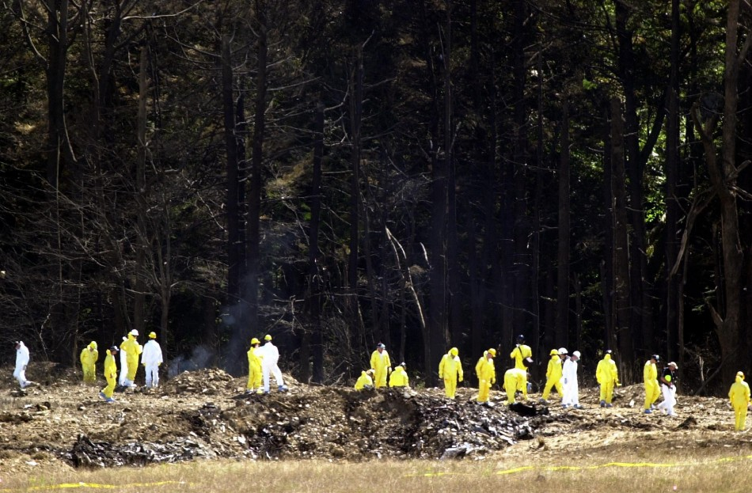
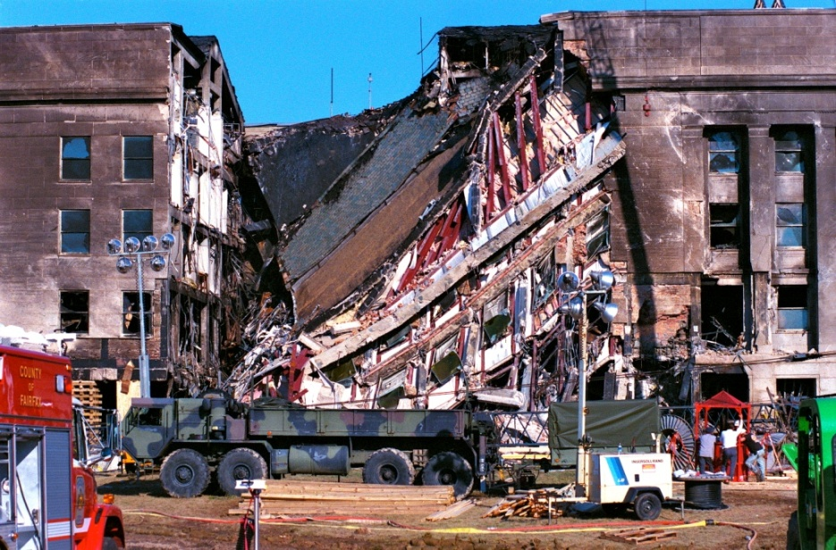
Shanksville, PA
Ibtimes.com
World Trade Center
Copyright: James Nachtwey
The Pentagon
Osha.gov

Slide 4
2977
Lost their lives

Slide 5
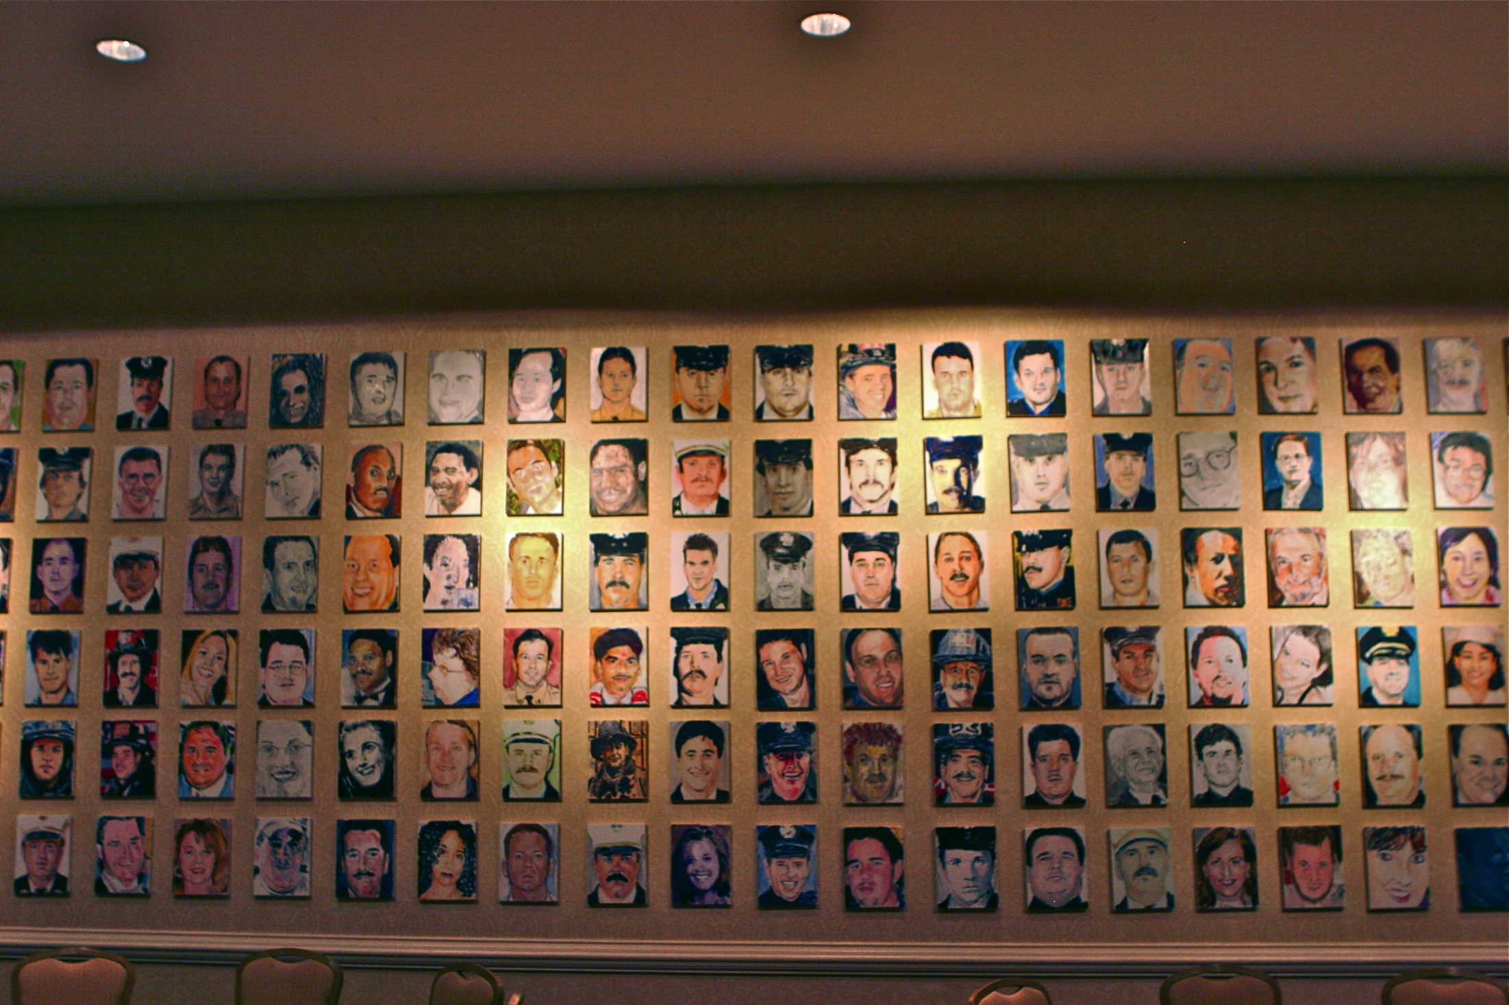
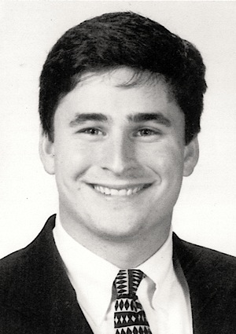
Bradley James Fetchet
November 17, 1976 – September 11, 2001

Slide 6
VOICES Mission
Provide information and support services that promote resiliency in the lives of all those impacted by 9/11.
Share best practices to assist communities in preparing for and responding to traumatic events.
Advocate for public policy reforms to promote national preparedness.

Slide 7
Advocating for Change
Notification of remains
9/11 Commission
The National September 11
Memorial and Museum
Long-term needs of victims’ families, responders and survivors
Voices of September 11th Archive

Slide 8
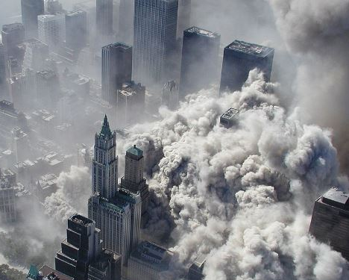
NYC Police Aviation Unit

Slide 9
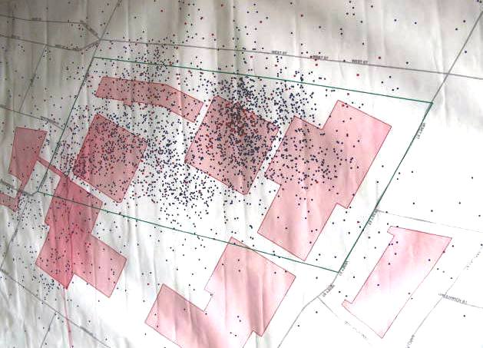
World Trade Center Site
Voices of September 11th Archive

Slide 10
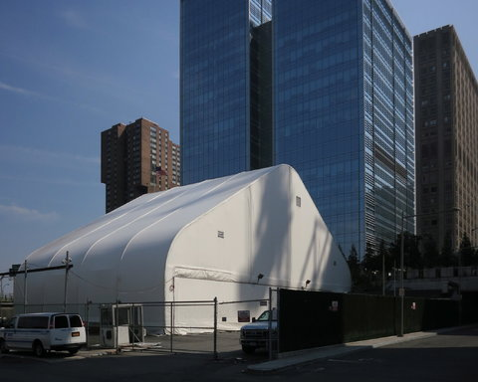
Collection of Human Remains
Largest crime scene in U.S. history
Documenting missing persons
Destruction of the site led to lengthy recovery process
Collection of DNA samples
No unified notification process
The New York Times

Slide 11
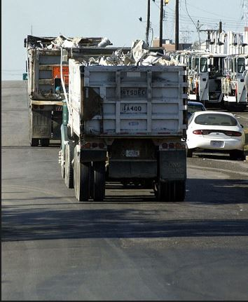
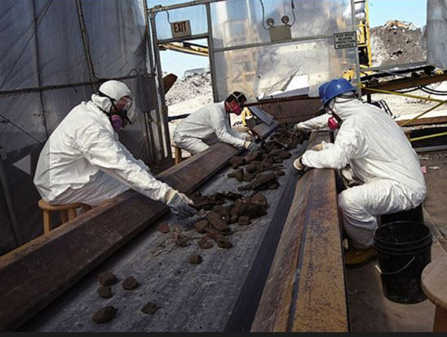
Identification and Notification of Human Remains
19,963 human remains collected between 2001-2005
DNA identification process evolved over time
1,640 of the 2,753 victims at the WTC identified
Silive.com
Silive.com

Slide 12
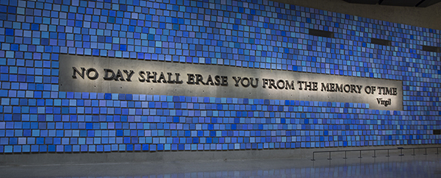
Final Resting Place for Human Remains
Voices of September 11th Archive

Slide 13
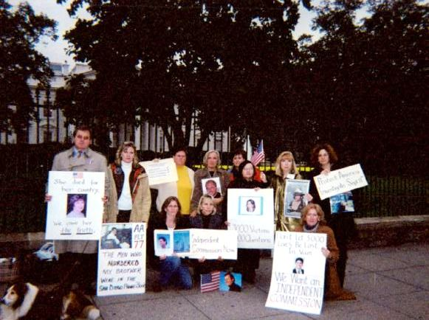
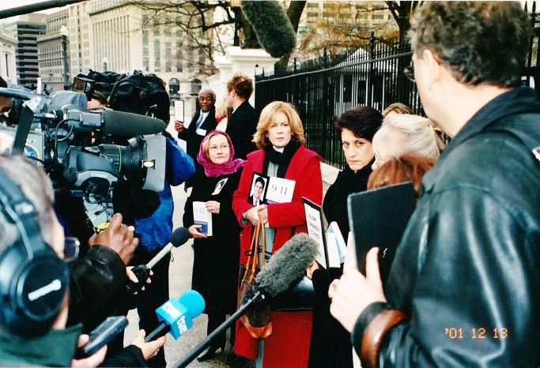
Advocating for Government Reform
Voices of September 11th Archive

Slide 14
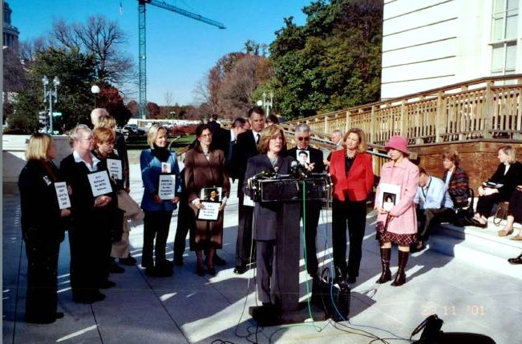
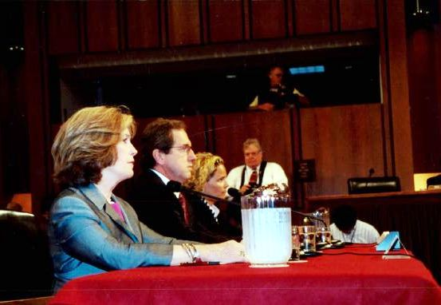
Supporting the 9/11 Commission
Voices of September 11th Archive

Slide 15
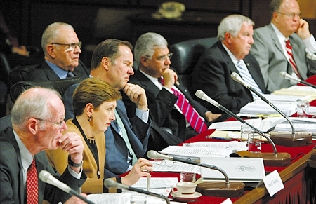
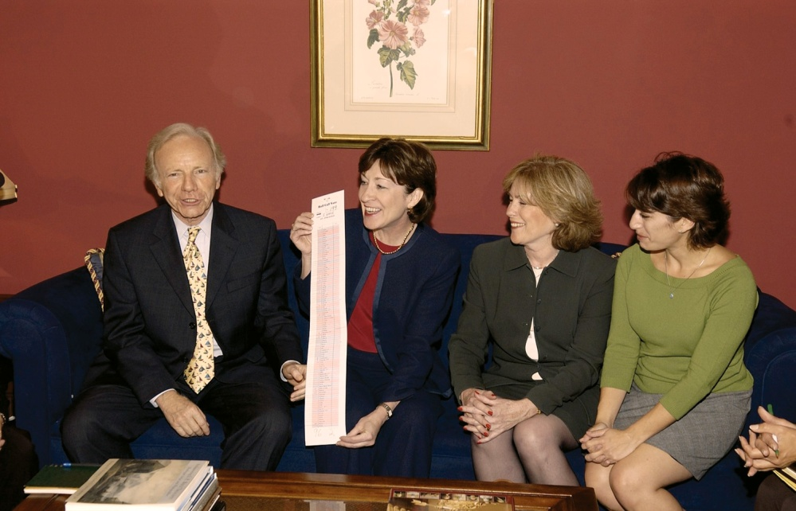
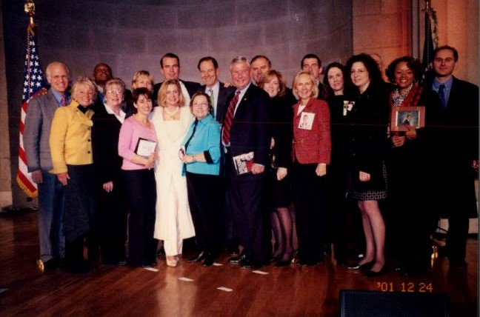
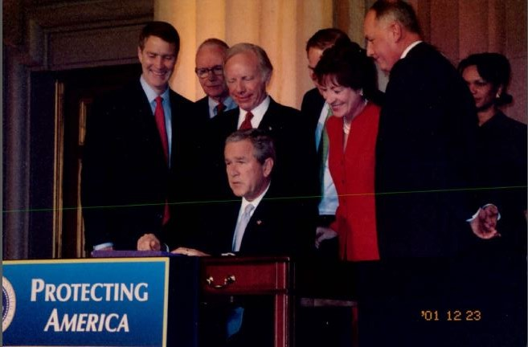
Implementing 9/11 Commission Recommendations
Voices of September 11th Archive

Slide 16
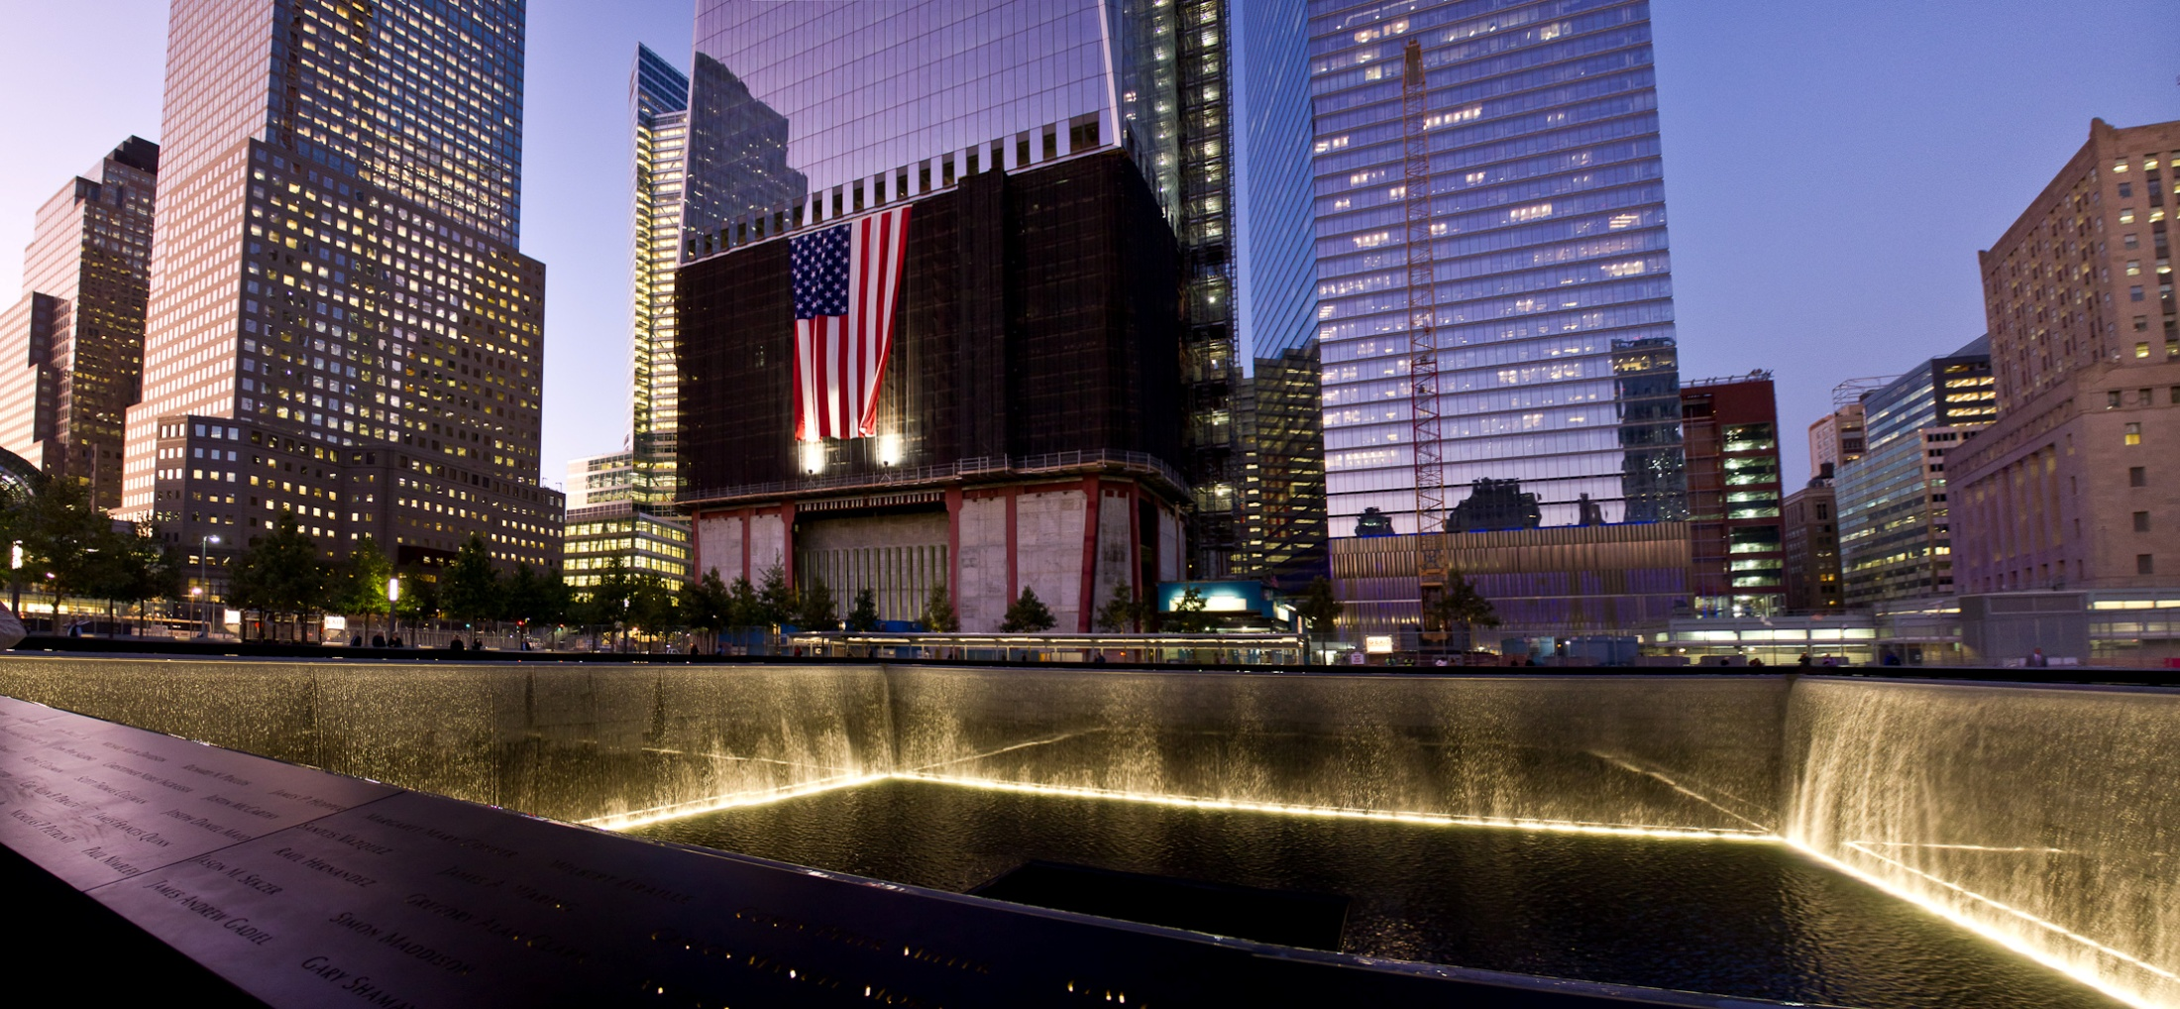
Memorialization
Stuart Greenberg

Slide 17
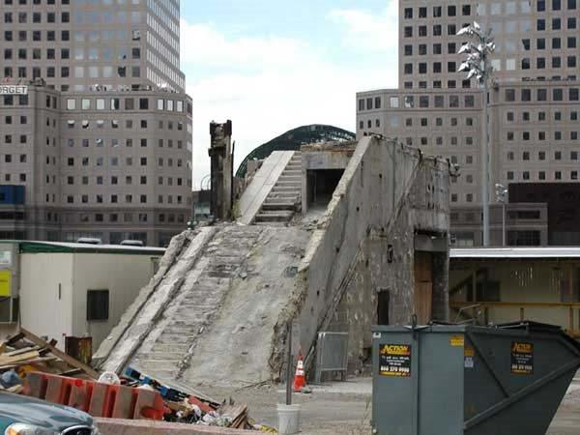
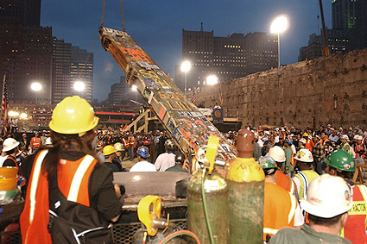
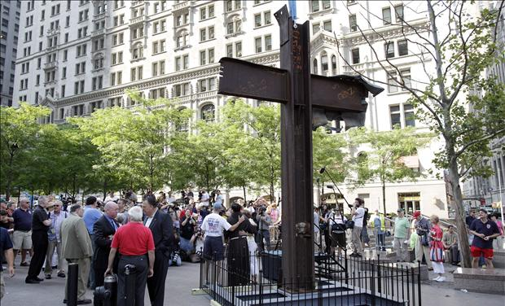
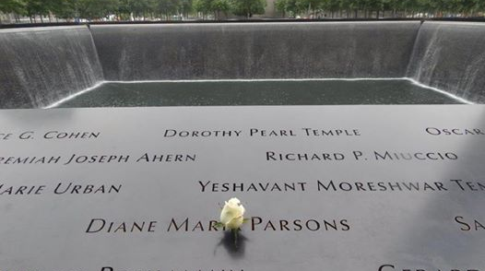
Preserving Artifacts
Care2.com
Bob Houlihan
NY Post
Daily Gazette

Slide 18
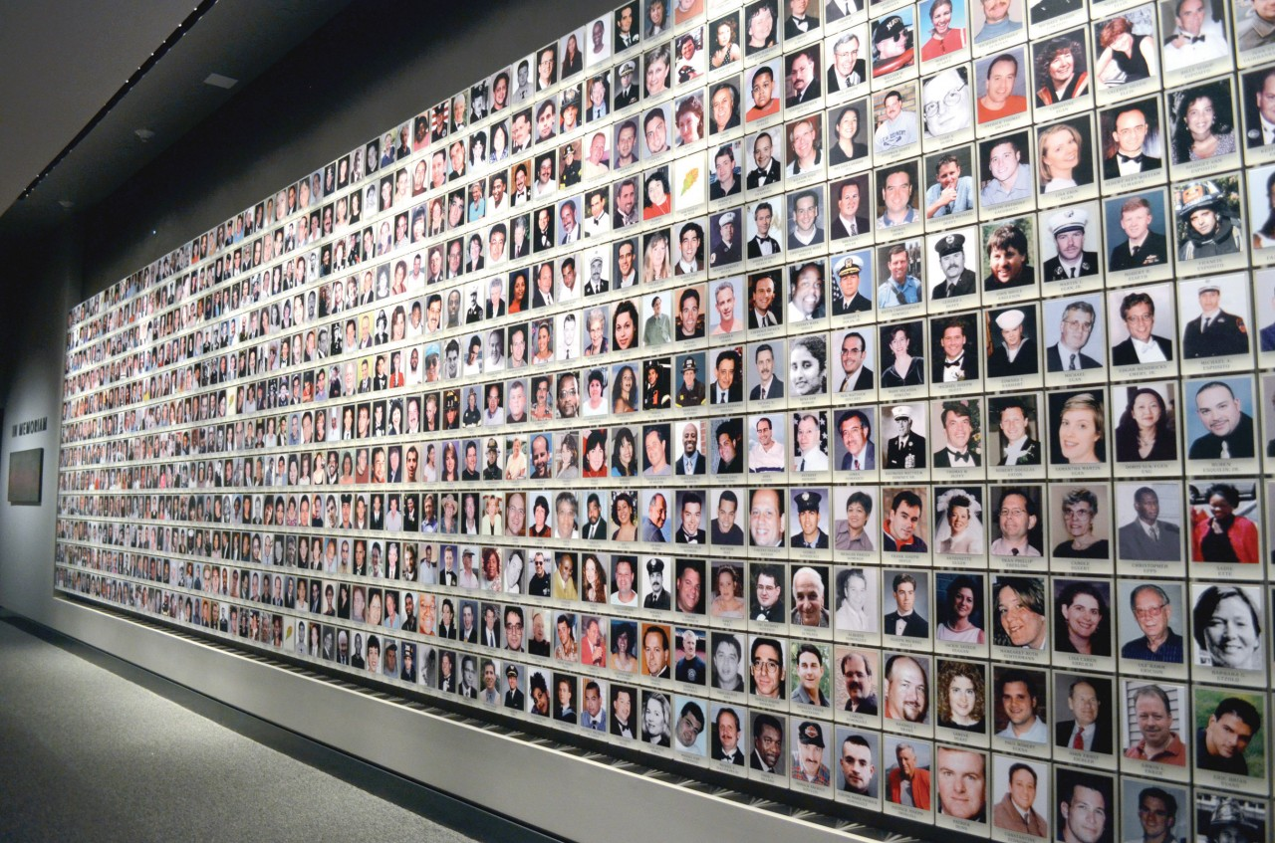
Honoring the Lives Lost
Voices of September 11th Archive

Slide 19
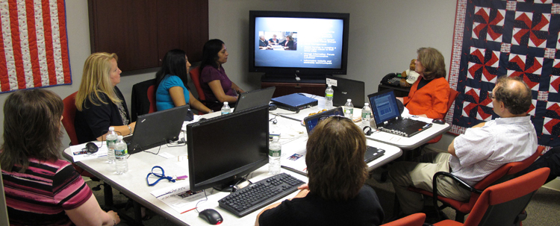
Long-Term Needs of Victims’ Families, Responders and Survivors
VOICES Resilience Center
Voices of September 11th Archive
Draws on 13 + years of experience
Shares lessons learned
Provides clearinghouse of information
Contributes to learning in field of trauma through research
Develops curriculum and training materials
Promotes public/private partnerships with subject matter experts, government agencies, non-profit organizations, universities

Slide 20
“I was fine for 12 years. I can’t understand why I need help 13 years later.”
“The loss of my loved one has left an indelible mark on my heart.”
You don’t “get over it.” You learn to live with it and create new meaning in your life.

Slide 21
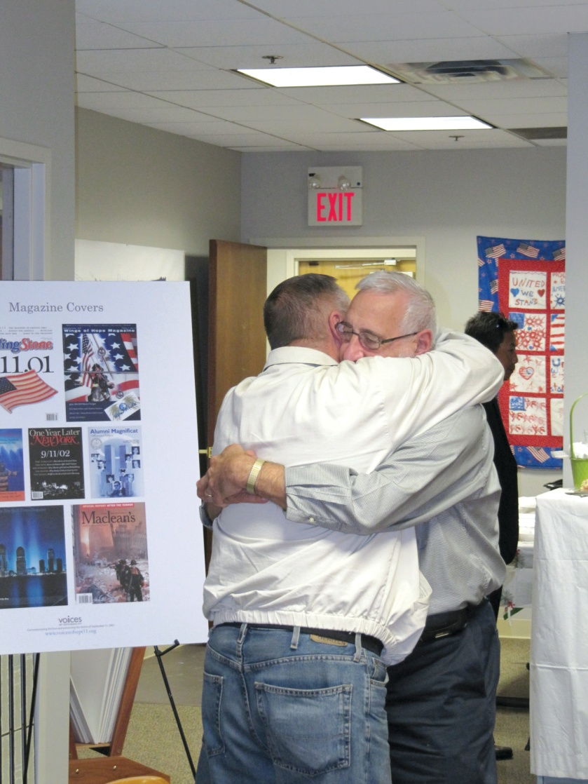
Psychological Outcomes
Bereavement
Anxiety and depression
Complicated grief
Ambiguous loss
Post-traumatic stress
Post-traumatic growth
Relationship problems
Intergenerational issues
Substance abuse
Voices of September 11th Archive

Slide 22
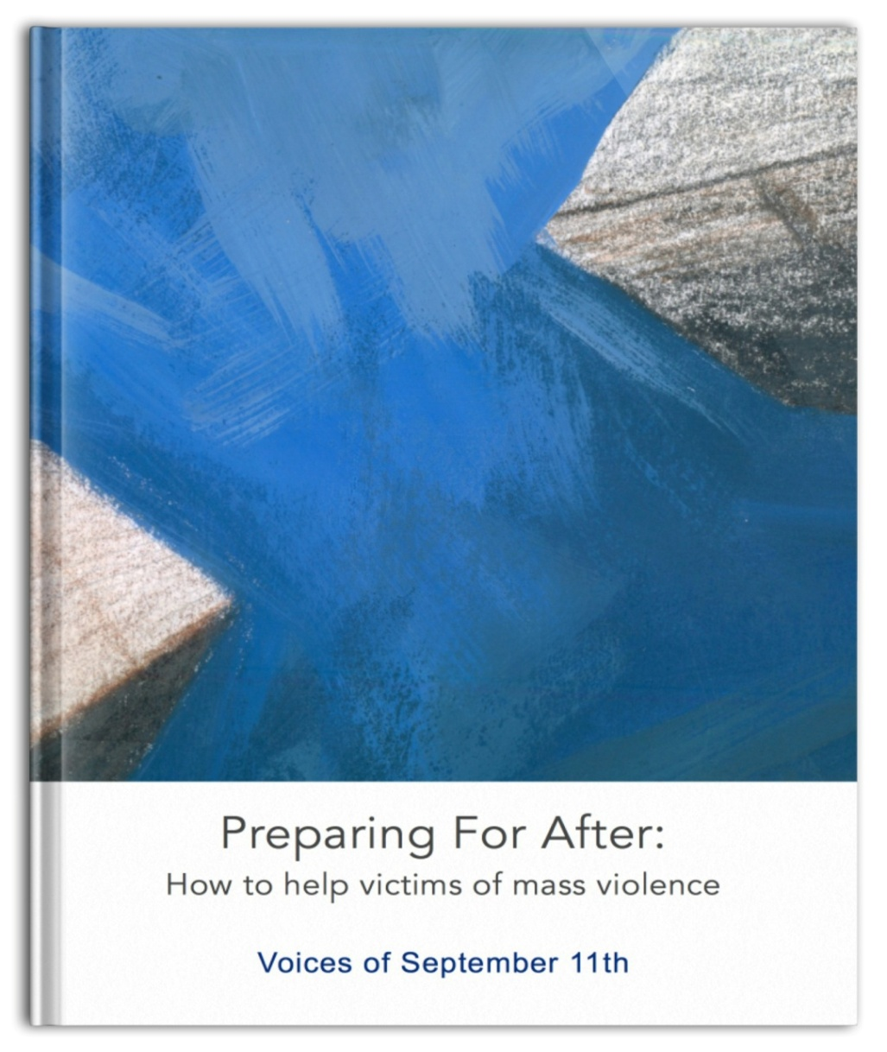
DOJ Office for Victims of Crime Resource Kit
Oklahoma City bombing
Virginia Tech University
Northern Illinois University
Tucson, Arizona
NYC and Pentagon
Voices of September 11th
Scholarly Research
Voices of September 11th Archive

Slide 23
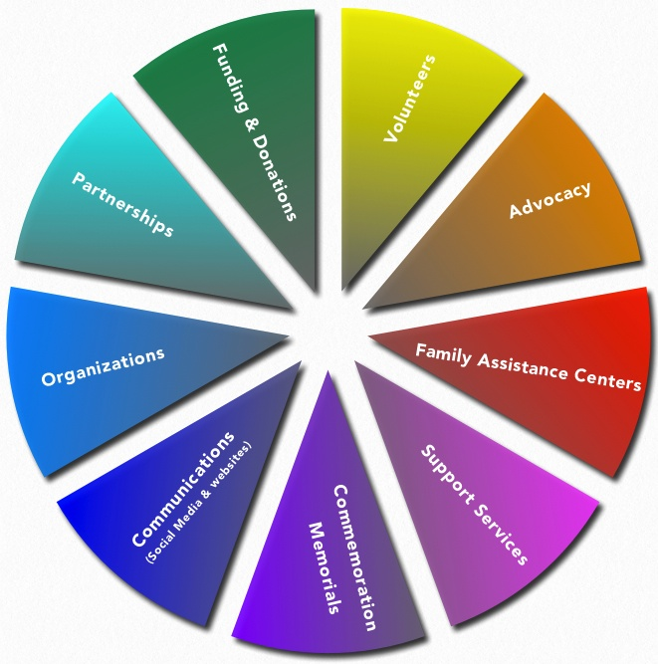
Best Practices Segmented Into Primary Categories

Slide 24
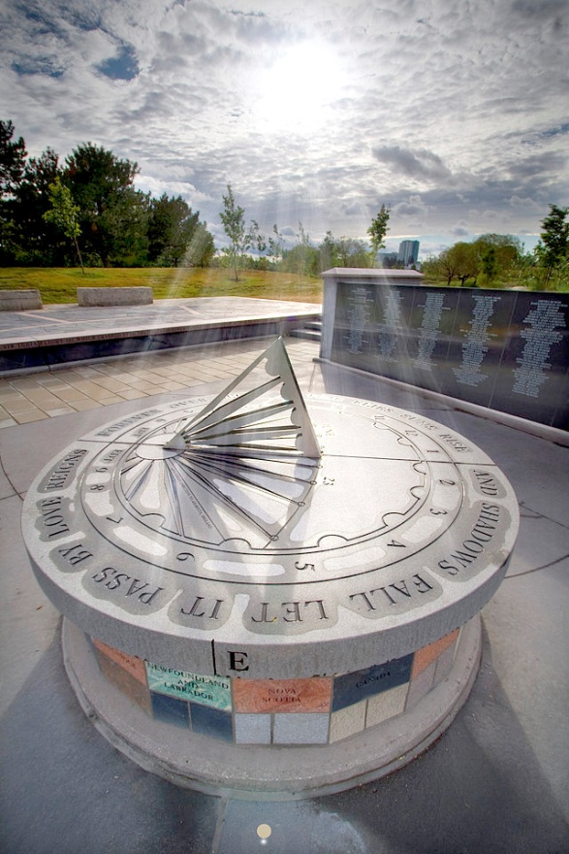
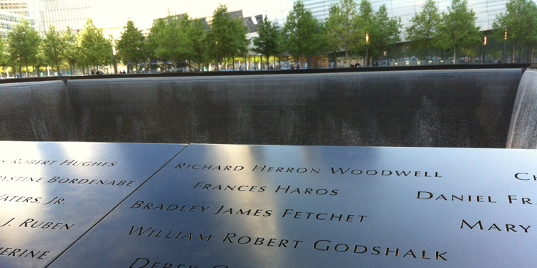
Kanishka Project Study Announcement
Investigating the long-term impact of bereavement
due to terrorism: factors that contribute to trauma,
grief, growth and resilience
Voices of September 11th Archive
Wikipedia
National September 11 Memorial
Air India Flight 182 Memorial

Slide 25
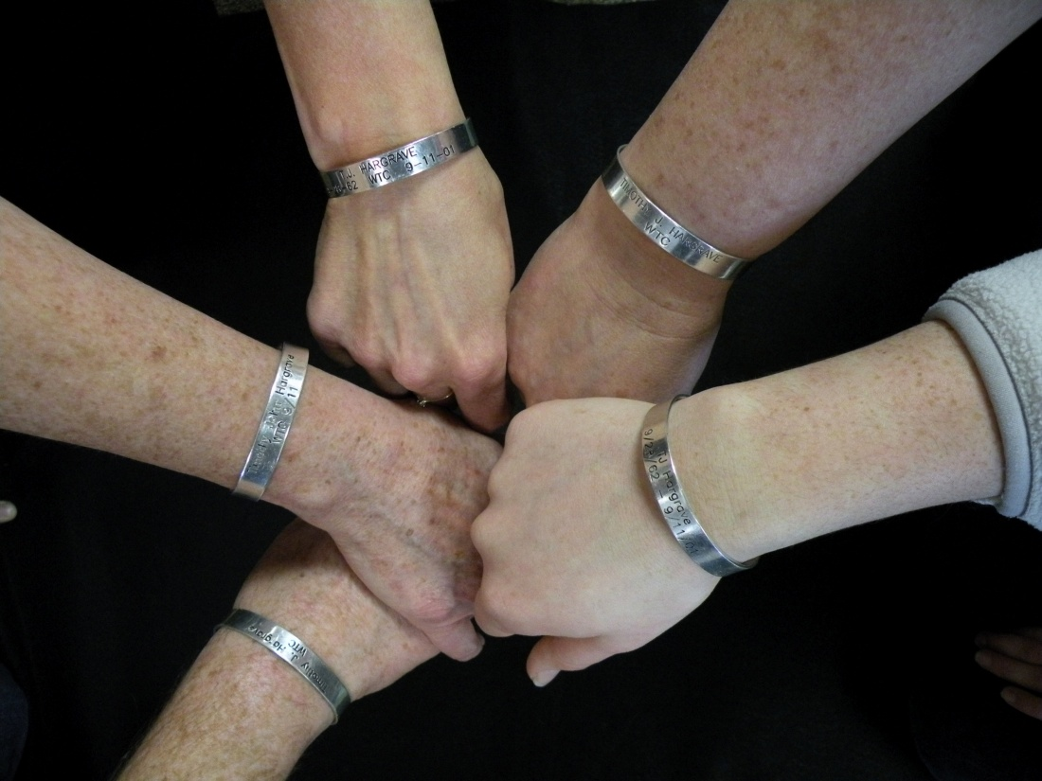
Voices of September 11th Archive
“Understand that we have an obligation not only to remember the past, but to imagine, and create a better future.”
- Secretary of State Hillary Rodham Clinton

Slide 26
Contact: Mary Fetchet
mafetchet@voicesofseptember11.org
203-966-3911
Visit us online: www.voicesofseptember11.org
Follow us on Twitter: @VOICESofSept11
Like us: facebook.com/voicesofseptember11

