Slide 1
Western Foreign Fighters
Joseph A. Carter
International Centre for the Study of Radicalisation, Research Fellow

Slide 2
Focal Points
Estimates and demographics
Embracing SOCMINT
Finding fighters through social networks
Radicalization
Activities in Syria and Iraq
Concluding thoughts
Notes:
Macro-level
Finding New Fighters on Social media
Radicalisation
Online activity before traveling to Syria
Friendships, contacts online and offline
Activity while in Syria and Iraq
What weapons have they learned to use?
Where do they go?
Are they participating in crimes?

Slide 3
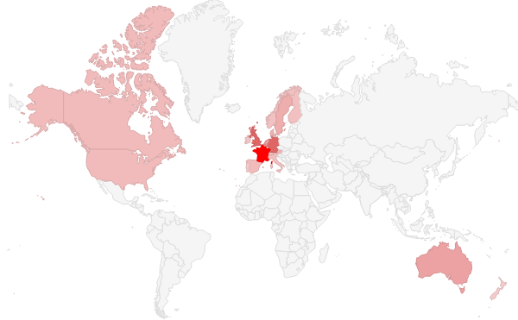
Latest Estimates
~20,000 fighters from 50 countries
Over a fifth come from Western Europe, Australia, Canada, New Zealand, and the United States of America
Largest contingents (raw):
France – 1,200
United Kingdom – 600
Germany – 600
Most heavily affected (per capita - millions):
Belgium - 40
Denmark - 27
Sweden - 19
Notes:
ICSR’s latest estimates, produced in collaboration with the Munich Security Conference. Our high estimates are that around 250 originate from Australia and New Zealand, 100 from both the US and Canada, and nearly 600 from the United Kingdom. Belgium and France are some of the most heavily affected with 440 and 1200 respectively.
~20k – surpasses Afghanistan
Most Affected:
Moving away from raw numbers into per capita we see countries like France (18) and Belgium (40) remain some of the most affected, but Sweden (19), Netherlands (14.5), Denmark (27) and even Norway (12) jump in terms of potential risk.
One figure - calculated in a conservative and thoughtful study by Thomas Hegghammer – suggests that 1 in 9 foreign fighters are associated with terrorist attacks or failed terrorist plots. It’s important to note that
Database:
~600 men and ~100 women from Europe, Australia, New Zealand, Canada, and the United States
Of those, the most affected Countries appear to be France, Belgium, Germany, the United Kingdom, and Sweden
The numbers from our current estimates track well with figures in our data base. The only difference being that Australia and Sweden appear to be over represented in the ICSR database, this is perhaps due to external factors like social media adoption or security practices adopted by factions from various countries.

Slide 4
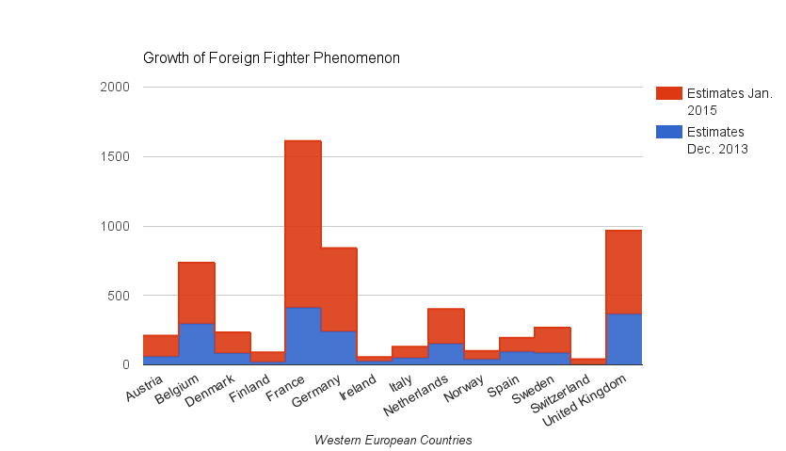
Latest Estimates
Notes:
France (300%), Germany (250%), Denmark (179%), UK (164%)

Slide 5
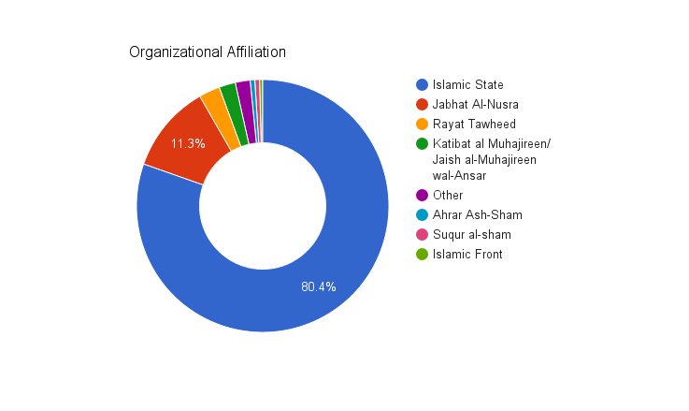
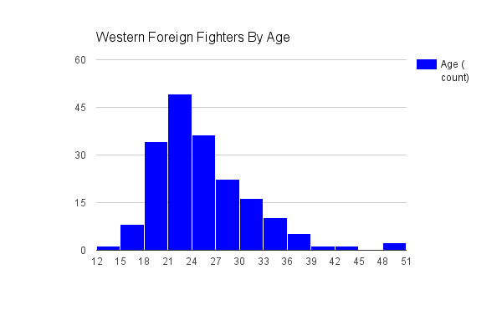
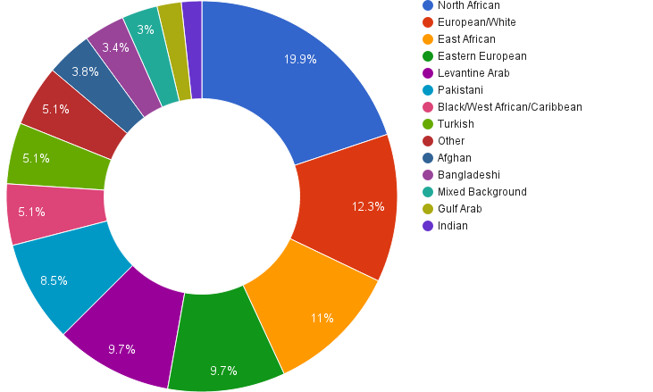
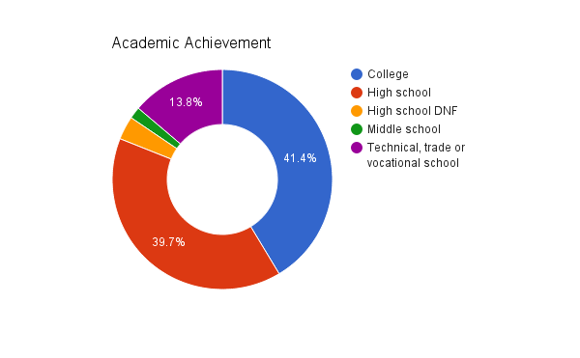
Demographics
Notes:
-80% to IS, 11% to JN
-Peak ages are 18-27
-North African ~20%, but no ethnic or racial category dominates – European/White, East African, and Levantine Arab are also very well represented
-41% have attend some form of higher education, about 20% have attended a technical school of some kind, 39% have at least attended high school
I want to highlight, that these are from our database - they are aggregate figures - and therefore may not reflect the experiences of individual countries

Slide 6
Embracing SOCMINT
Term coined in 2012 by Sir David Omand, Carl Miller, and Jamie Bartlett
“In an age of ubiquitous social media it is the responsibility of the security community to admit SOCMINT into the national intelligence framework”…
Only if it rests on a solid methodological bedrock and moral hazards of collection can be managed.
One of the principal leadership challenges for intelligence and law enforcement agencies.
Notes:
Why principal challenge?
Already outlined today, so sort of spoiled my talk
[haha]
Differences between public and LE/Intel over definition of privacy
Lack of a clear understanding about how data is used and the mechanisms in place to prevent abuse
Future of open source data collection – which is already here – is on social media.
Enormous task to select, integrate, manage, and uncover insights from mountains of data being produced everyday.
Remember to give a head nod to Mubin Sheikh, JM Berger, Shiraz, Melanie, Aaron Zelin, and Aymen Tamimi

Slide 7
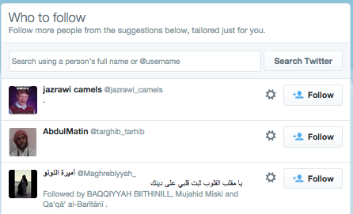
Finding New Fighters
Bottom-up curation – Fighters, sympathizers, fanboys “promote new fighter accounts.
Recommendation Algorithms – Twitter has a built in recommendation algorithm, small “seed” of interesting will be enough to generate results.
Connectivity – Social graph is at the heart of Twitter, Facebook, and other social media platforms.
Notes:
Bottom-up Content Curation:
Bottom-up content curation results in fighters and sympathizers “promoting” new fighters and fighters who have had to make new accounts due to suspensions.
Recommendation Algorithms:
Twitter and Facebook include recommendation algorithms as part of their package of services to users. This helps to increase connectivity and improves user experience by finding friends or other users of interest (e.g. finding old friends from high school or Twitter accounts you might be interested in).
After cultivating a small cohort of interesting accounts, the recommendation algorithm identifies new accounts we might be interested in following.
Connectivity means interactions and friendships can be used to identify new fighters/persons of interest or new accounts created after a suspension.
We can use these three aspects of social media to our advantage in finding foreign fighters, allowing users and the services themselves to help us identify users of interest.

Slide 8
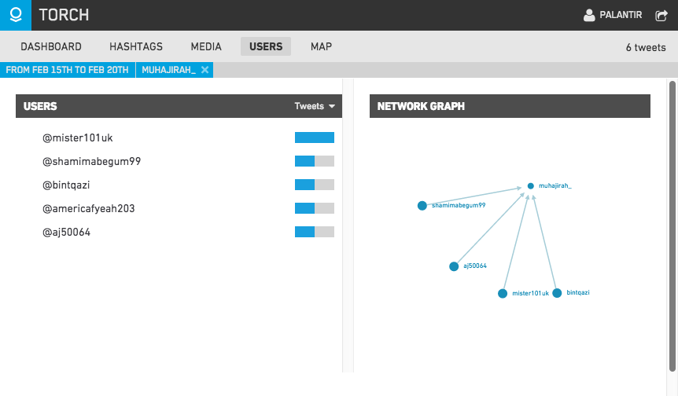
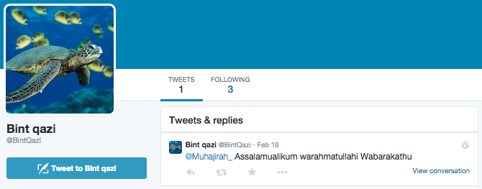
Finding New Fighters
Notes:
This process can be replicated in similar fashion on Twitter.
Using Torch we can identify users that contact or are contacted by foreign fighters/persons of interest.
In this example we can see that from 15/02/2015-20/02/2015 four users contacted Twitter user Muhajirah_, who is believed to be Aqsa Mahmood – a women who allegedly travelled to Syria in December.
In Torch we can visualize these interactions, and see there content. In this case one of these interactions is a tweet from Shamima Begum requesting to direct message (DM) with Aqsa Mahmood. This was Shamima’s only tweet.
We may also what to check out user BintQazi, whose only tweet is a welcome message to Muhajirah_

Slide 9
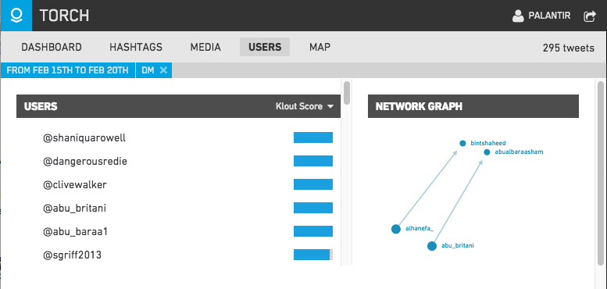
Finding New Fighters
Notes:
We can replicate this process using keywords or hashtags instead of specific users.
In this example we used the same time period and searched for the keyword “DM” searching for requests for private discussions with foreign fighters or other persons of interest.
We’ve collected 295 tweets containing “DM” during this period (that’s not all of the tweets on Twitter). On of them is between Abu Abdullah Britani (Abu Rahin Aziz) and Abu Albaraa Sham (now TouristSham) – a “charity worker” from Australia who has expressed support for the Islamic State.

Slide 10
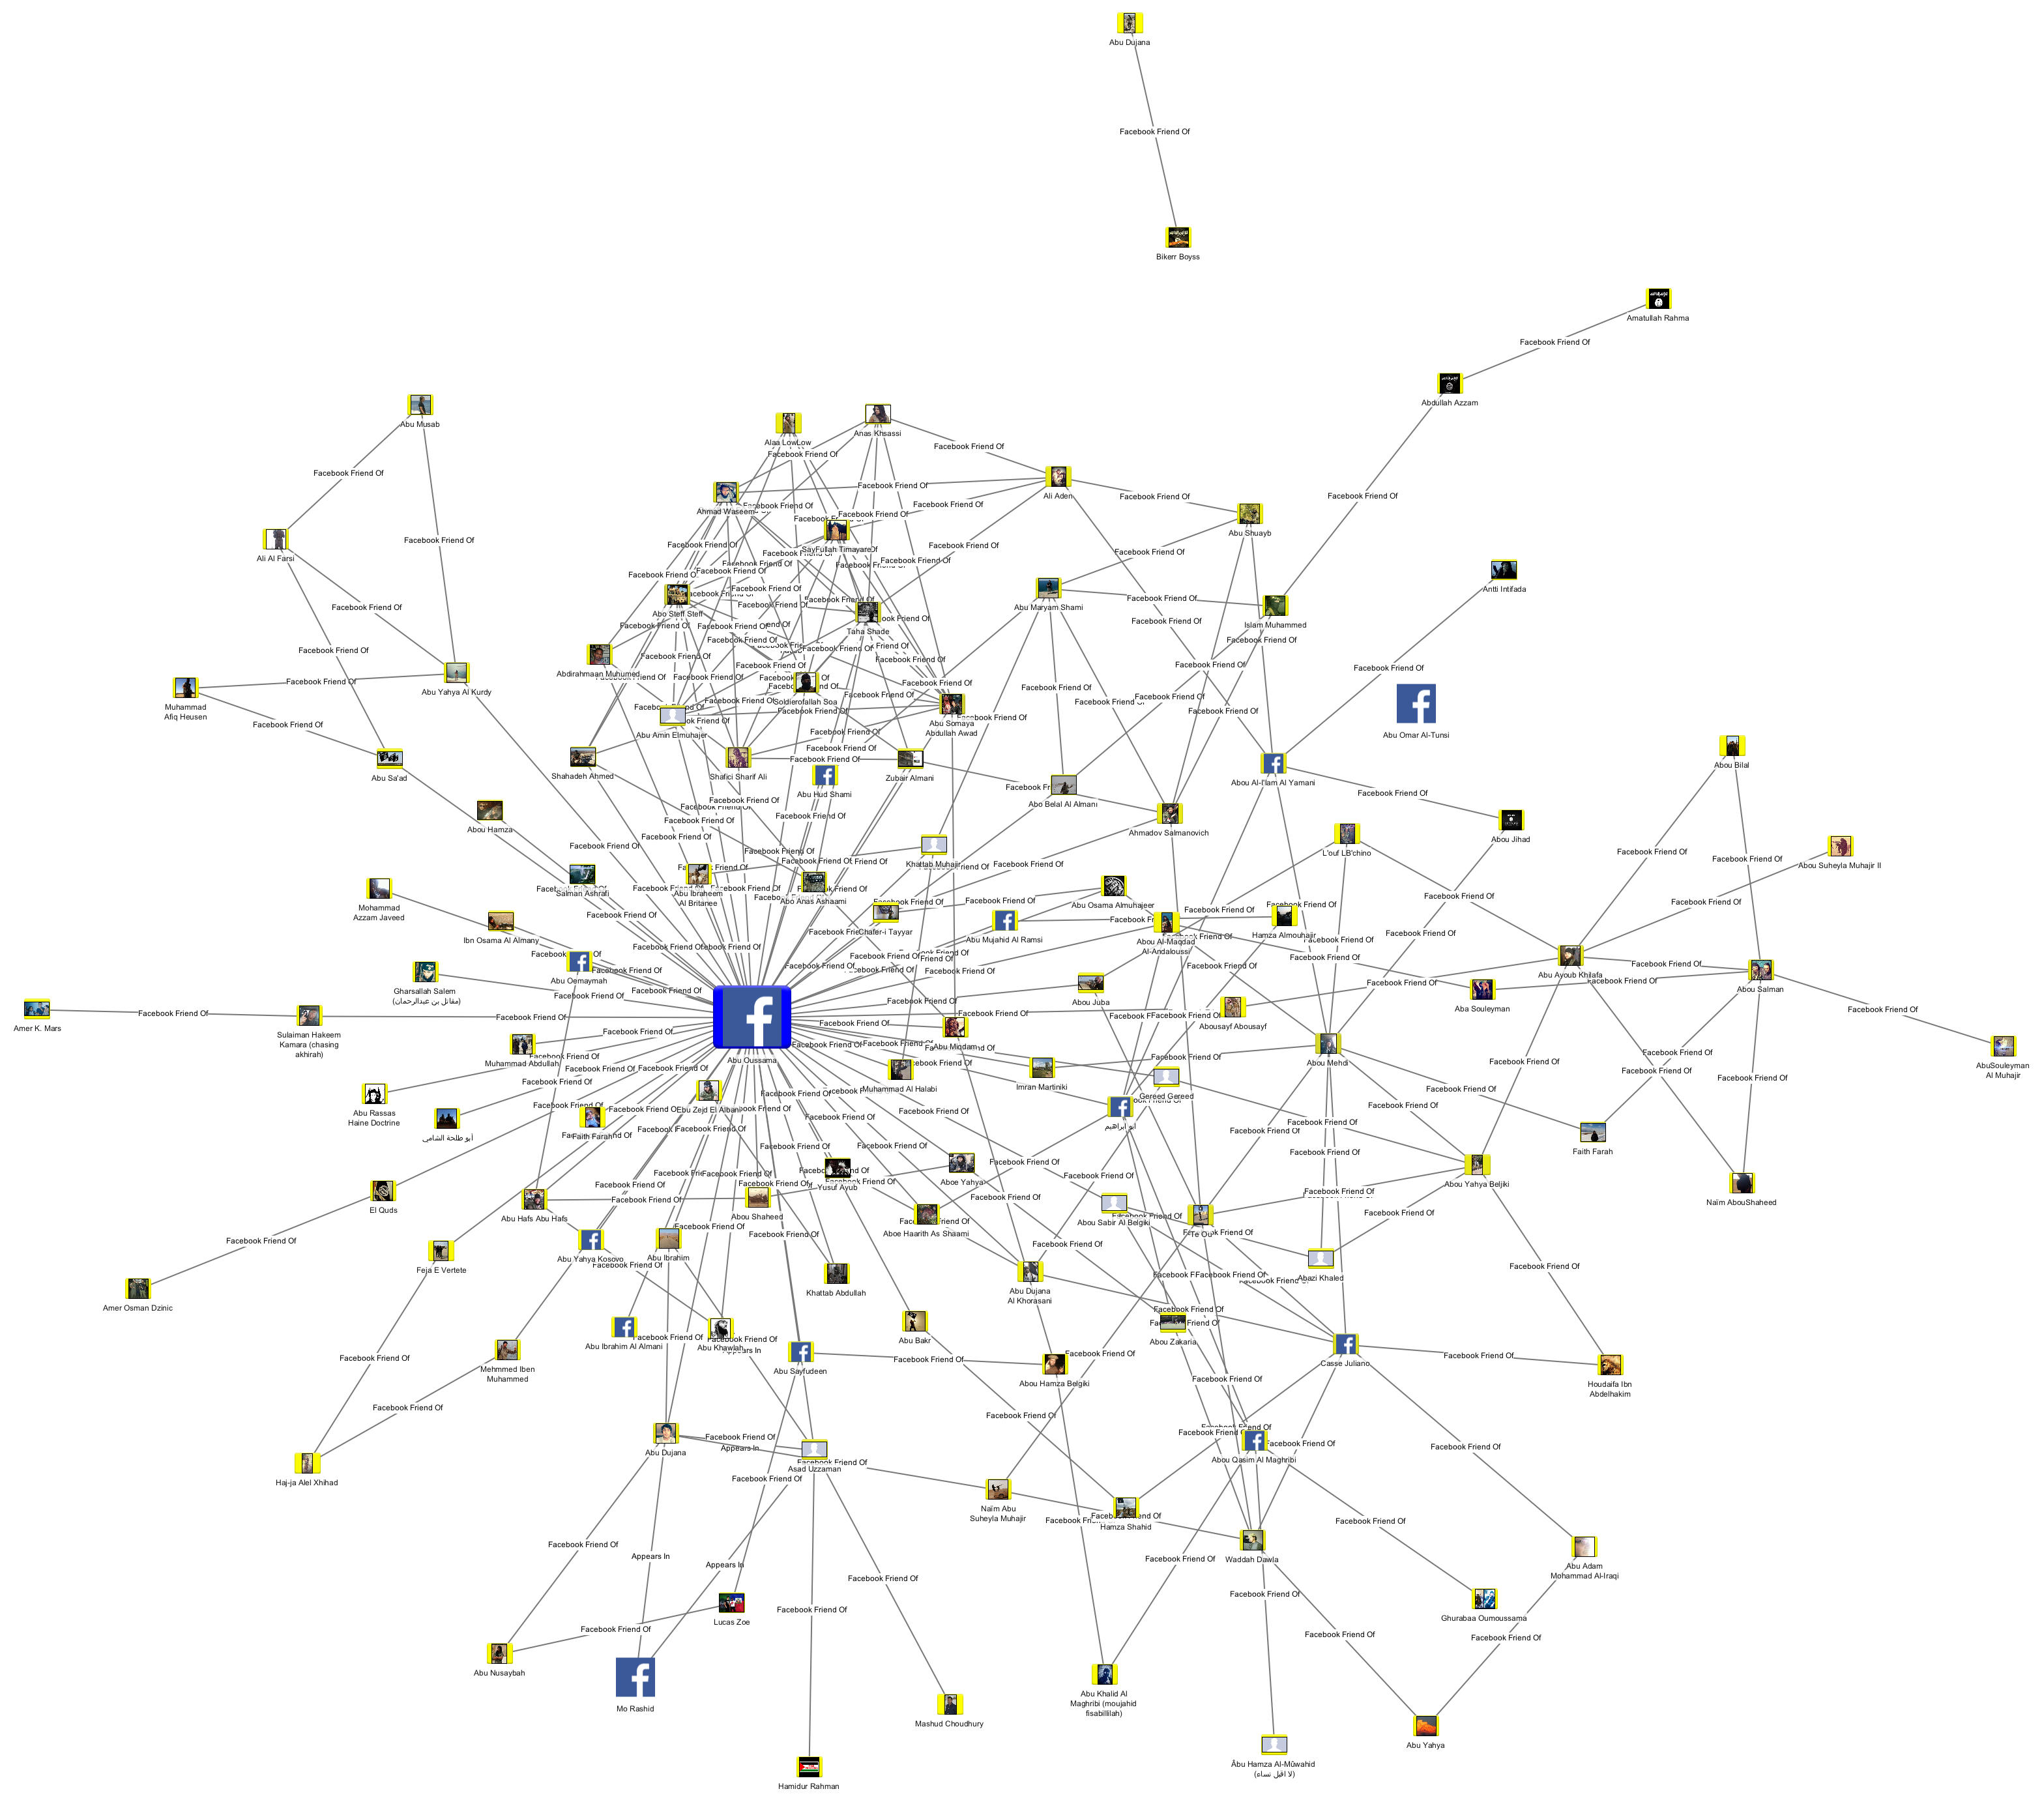
Finding New Fighters
Notes:
Previously we had to use “brute force” techniques, literally scanning all of the publicly-available friend lists of every fighter, looking for new fighters and developing internal mental lists of recurring users who showed up as friends of multiple fighters. This became unsustainable very quickly, with hundreds of fighters with thousands of friends.
To solve this problem we had Palantir develop a Chrome Extension for Palantir Gotham that imports the publicly available friends list of suspected fighters.
We use this tool to a) keep a record of the fighters’ social networks and b) to identify new foreign fighters or people of interest.

Slide 11
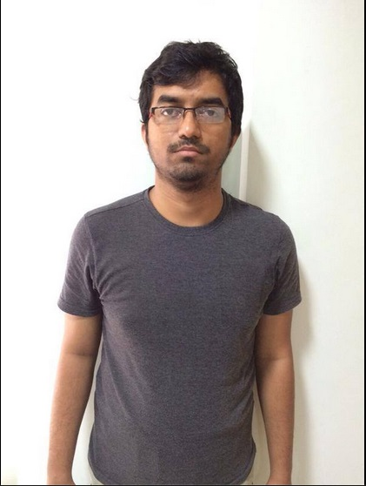
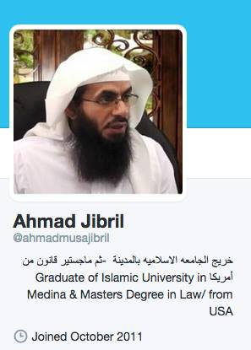
Radicalization - Online Factors
Pain of inaction
Online communities of support
Access to direct one-to-one communication with fighters on the ground
Source of practical knowledge
Disseminators, online clerics –though leaders
Birds of a feather or influence?
Notes:
Foreign fighters are often digital natives – young people who have grown up using the internet.
We can leverage this fact to our advantage, finding digital footprints of their past online activity to help us better understand their path towards radicalisation and other facets of their lives prior to going to Syria. Including old posts on blogs, Facebook, or other platforms.

Slide 12
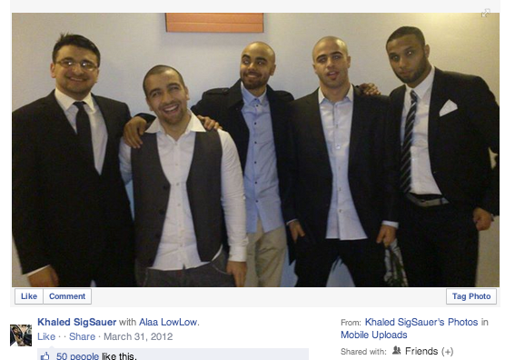
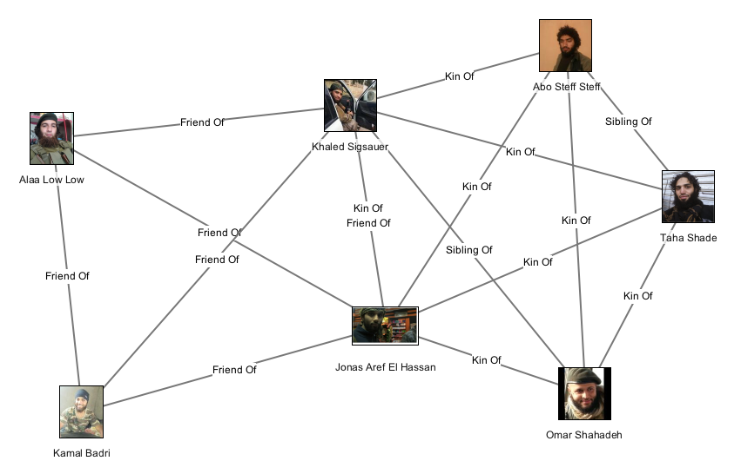
Radicalization - Offline Factors
Offline peer groups appear to play an important factor in many cases of radicalization.
Example cases: Portsmouth, Cardiff, Gothenburg
Both online and offline networks have been found to act as a conduit into Syria.
Birds of a feather problem, again.
Can’t prove a negative
Notes:
Some of the information can be coded as relational information and input into Palantir Gotham.
On the top right we have photo found on the account of a foreign fighter, showing the fighter with four other friends – three of whom became foreign fighters themselves.
Below we’ve coded the data as offline friendship information and then graph it in Palantir Gotham. This can be used to identify potential factors in the radicalisation process – in this case the presence of friends who also became fighters – as well as potential problem areas (if they all originated from the same neighborhood).
We can do the same with information related to da’wah groups, mosques, etc to identify potentially problematic groups (Sharia4Belgium in Belgium, Profetens Ummah in Norway).

Slide 13
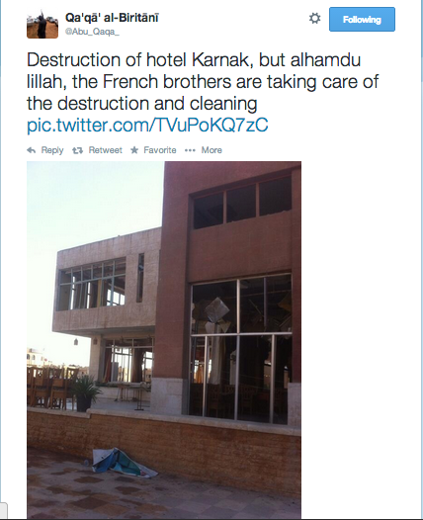
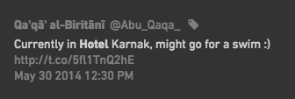
Activities in Syria and Iraq
Activity while in Syria and Iraq can be useful in identifying:
Weapons operated by foreign fighters, which can then be used to assess the potential threat posed by foreign fighters
Locations visited by foreign fighters
Potential crimes committed while abroad.

Slide 14
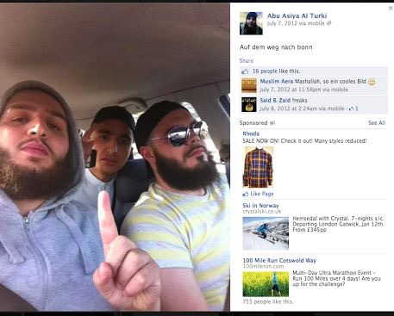
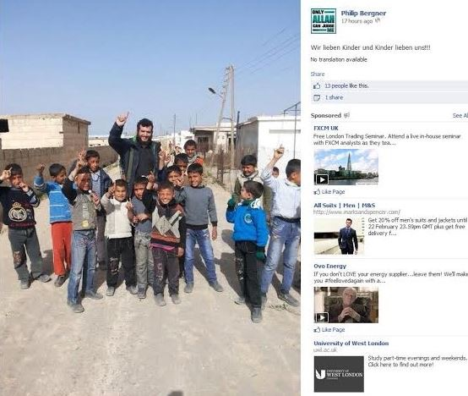
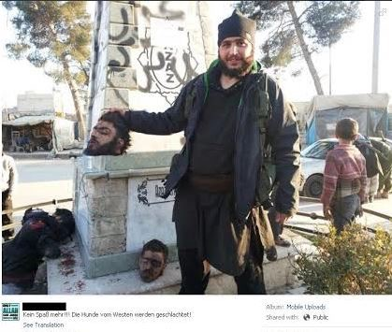
Activities in Syria and Iraq

Slide 15
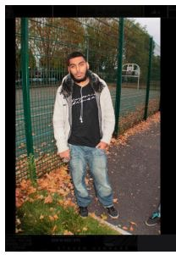
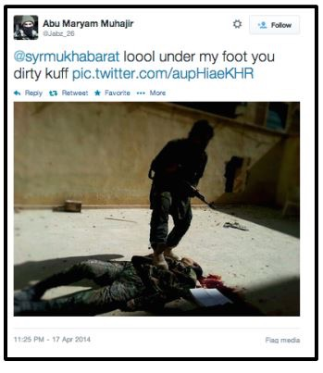
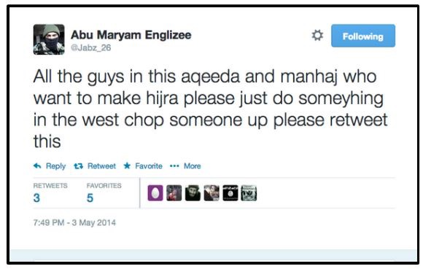
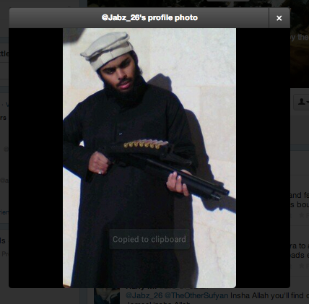
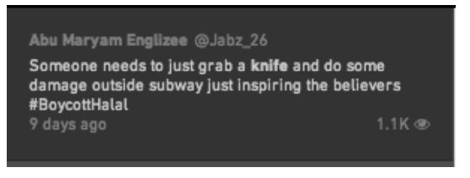
Activities in Syria and Iraq

Slide 16
Concluding Thoughts
Foreign fighter phenomenon has expanded enormously in the last two years, leaving the LE/Intel communities with a vast problem set that isn’t going away in the near-term.
SOCMINT is one of the seminal challenges for these communities, especially the around questions of data collection, integration, and analysis.
Partnering with the academic and private sectors is key – both sectors have a entrepreneurial spirit about knowledge production.
Encourage tinkering, create spaces within your community for the types of experimentation that acknowledge the importance of failure in discovering new answers to complex problems.

