Slide 1
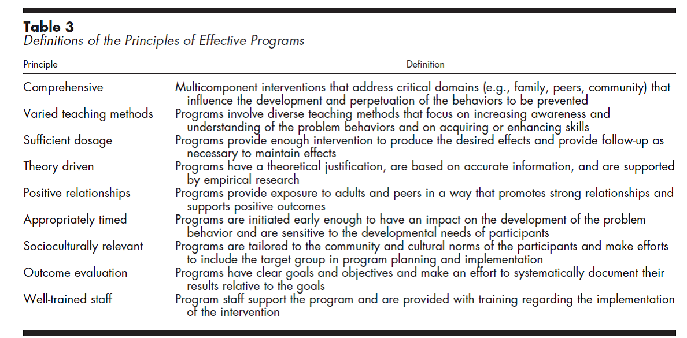
Principles of Effective Prevention Programs. Nation, M., Crusto, C., Wandersman, A., Kumpfer, K. L., Seybolt, D., Morrissey-Kane, E., & Davino, K. (2003). American Psychologist, 58, 449-456. *Prepared for the Centers for Disease Control and Prevention, Division of Violence Prevention

Slide 2
Executive Summary
Unlike other models of CVE that have been developed the IVP has actually undergone five years of direct application testing and has been used to screen thousands of cases and removed dozens of terrorist social media pages and websites.
The following cases exhibit the actionable intelligence that has come out of IVP screening:
Canada:
Identified International Sikh Youth Federation extremist group members on Facebook with connections to other senior ISYF members in Surrey, BC. Firearms seized.
Identified eight Taliban websites being operated out of BC web hosting company.
Identified extremist members associated with Jabhat al Nusra, al-Shabaab. Chechen separatist groups and Hezbollah.
Australia:
Identified Australian residents with links to ISIS and street gang linked to Jabhat al Nusra where three of its members were arrested in the latest raids in September.

Slide 3
United Kingdom:
Identified charities and Gurdwaras with links to the Sikh terrorist group.
The IVP has identified over 140 UK residents with links to the ISIS including foreign fighters.
Belgium and the Netherlands:
Identified and screen over 2000 members of “De Basis” linked to Jabhat al Nusra in Syria.
United States:
Identified threat to US embassy in Kenya.
Identified al-Shabaab links to Minnesota.
Identified US residents with links to ISIS.

Slide 4
IVP – Identifying Vulnerable Persons Guide
Level 1: Concern & Consultation | Level 2: Active Intervention/Monitoring | Level 3: Reporting & Referral to law Enforcement
Neg. peer influences: gang involvement – criminality – hate linked violence | Pol. Activism, charity work re conflict zones + propaganda distribution | Death rhetoric: glorification of terrorist/insurgent attacks/martyrdom
Period of perceived ‘Western’ hedonistic/corrupt behaviour | Hate rhetoric against West: “kuffar” – narrow interpretations of Islamic sources | Extremist group membership &/or participation
Conflict w/family over religious beliefs/lifestyle choices/marriage | Travel abroad to areas of known Islamist activity/conflict - madressa | Paramilitary training w/weapons & intel gathering
Rel. practices: lack of knowledge combined w/increased observance (dress, interaction etc.) | Seclusion/isolation apart from small group of like-minded – removal of friendships outside this group | Overseas combat participation through disclosure or gathered intel.
Isolation from exposure to cross-cultural influences | Basic paramilitary training | Contact w/known extremists/recruiters
Violent rhetoric

Slide 5
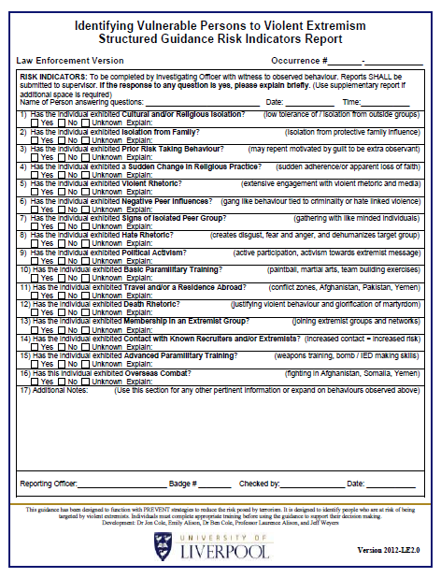
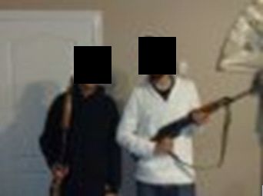
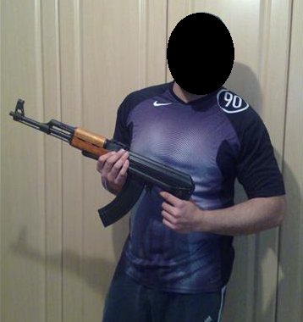
Negative Peer Influence
Hate Rhetoric
Basic Military Training
Extremist Group Membership
Contact known Extremist

Slide 6
Trusted Intermediaries Volunteer base: Community elders
- Religious actors - Professionals from the community (lawyers, doctors, teachers, social workers etc.)
Subject Matter Experts - Practitioners and experts from government including policy makers, public safety agencies, academics etc.
Cooperation & Transparency Separation of roles & responsibilities incl. Duty to Report
Subject Matter Expert Evaluation - Program data collection, analysis and publication. Provision of documentation as produced by official and academic sourcing.
PREVENTION & INTERVENTION FRAMEWORK
Intervention Components - Attending courts, Parole Board etc. regarding general, justice-related interactions (in confidentiality). - Training and implementing of professional counselling practices related to harm reduction and positive decision-making
- Visits to correctional service sites and facilities on bi-weekly and monthly basis to offer time-limited as well as ongoing support services. - Specialists to deal with specific, radicalization and violent extremism related offences including counter-messaging along with rehabilitation and reintegration services via one-on-one sessions, involvement of parents, siblings, vetted video instruction, small-group, large-group and private study.
Prevention Components - Proactive, pro-social teachings - Interfaith and intercultural activities - Inclusion of males and females in community activities - Vocational training, educational support
Prevention & Intervention Client groups - Elderly - Married couples – Parents – Converts - Young adults – Teenagers - Children
- Community institutions including correctional and custodial facilities, agencies (social and justice related), schools, community cultural organizations etc.

